Slide 1
CS240A Final Project
Adventures in Azure

Slide 2
Project Group
Troy Altunel
Brady Esplin
Ryan Woodward
And a special guest appearance by:
Paul Skarda
Notes:
Paul had to pop in and see if he could help us out when our virtual machines crashed, it was very nice to have a tutor to call upon for help and ideas.

Slide 3

2/19/21: Setting up the Virtual Machines
Ryan had trouble giving Troy and Brady Permissions to do anything to the virtual machines, this was an ongoing issue with Azure affecting all actions up until 2/26/21 at which point Troy and Brady were made into Virtual Machine Managers and all issues ceased.
Notes:
2/19/21 (Ryan)
Setting up Azure VM: having permission issues when trying to connect to Ryan’s VM

Slide 4

2/20/21 Creating Domains and Associated Issues
Ryan created the Domain CS240Project.com on the server. Changed the DNS settings to point to the server and lost contact with the virtual machines. Which turns out to be a known Azure bug. The eventual solution was to redeploy the VM’s and both Windows 10 machines joined the domain.
Brady created users Sisi Virasak, Paul Skarda, Brady Esplin, Ryan Woodward and Troy Altunel in the Windows Server Active Directory
Notes:
2/20/21 (Ryan)
Created Domain on server. Ran into issues with azure when attempting to join the Windows 10 machines to the domain. I changed the DNS settings on the win10 machines to point directly to the server. After doing so, lost all connectivity to the vm. Tried several solutions, all failed. The answer turned out to be redeploying the virtual machines, after which connectivity was restored, and my dns setting changes were intact. Not sure if this is the correct method for doing this. I will look for more information on this.
Both Windows 10 machines joined to the domain.
(Brady)
Created Users Brady Esplin, Ryan Woodward and Troy Altunel on the Windows Server Active Directory

Slide 5
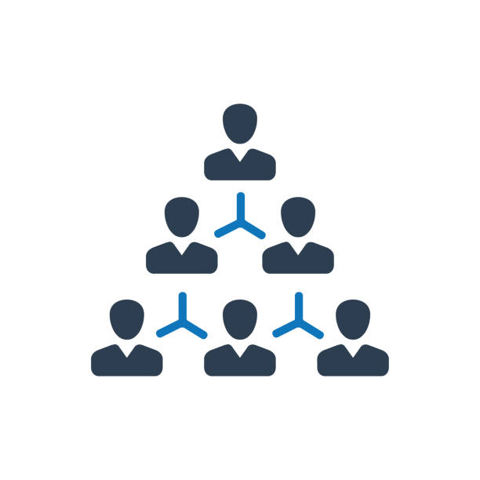
2/26/21 Group Objects and Users
Brady received a message when trying to log in that his account had violated the Microsoft Services Agreement and his account was locked. After logging in with a security code sent to his phone the account began functioning normally again.
Troy added several group objects including Teachers, Students, President, Deans and CS Department. Also added in several new users to populate those groups and set each group to be managed by the groups that would logically manage the other groups in the real world.
Notes:
2/26/21 (Brady)
Ran into issues with a locked Azure account: We've detected some activity that violates our Microsoft Services Agreement and have locked your account. No idea why this happened, but I was able to recover access to my account and login as normal after this.
Received server error message: Cannot manage a client based operating system when trying to manage cs240Troy using windows server manager
Added a “Teachers” Group Object, added Sisi Virasak and Paul Skarda to the group.
Added a “Students” Group Object, added Brady Esplin, Ryan Woodward and Troy Altunel to the group.
Set up group Teachers to manage group named Students
Added new users Lisa Avery
Added “President” group Object, added Lisa Avery to group, added Teachers group to be managed by President group
Added “Deans” Group Object, added new users Meg Roland, Kristina Holton, Steve Schilling to Deans group, set “Deans” group to be managed by President group
Added “CS department” added users Brady Esplin, Ryan Woodward and Troy Altunel to the group.
Set CS department to be managed by Deans OU

Slide 6

2/26/21 (cont.) Playing with Organizational Units
Troy added a separate Organizational Unit named Groups to add all the different group objects to but received a warning alerting us to the fact that this could affect how our group policy objects are applied. So at first we deleted that group but decided “Why not?” and made another group named Test. Nothing bad happened so we made a group named Group and moved the groups to the Group Object.
Notes:
Added separate Organizational Unit named Groups and tried to add all the different group objects to it, received a warning that this will alter how group policy objects are applied, so we didn’t end up using that OU for anything and ended up deleting it, having to go to advanced options and unprotect from accidental deletion in order to remove the OU from our domain.
Added Organizational Unit named Group again, to test what happens when we go ahead and add users. Added a group named Test for testing. Nothing bad happened so we went ahead and added all groups that we made to the OU called Group. We also moved all the groups that are in the domain by default into our new OU to see what would happen. Nothing bad happened so we are leaving the groups where they are for now.

Slide 7
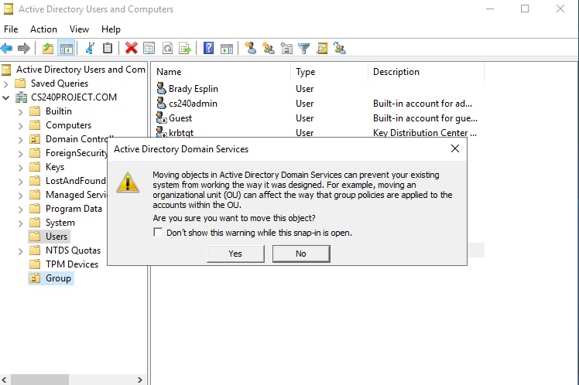
An Alert about moving Organizational Units

Slide 8
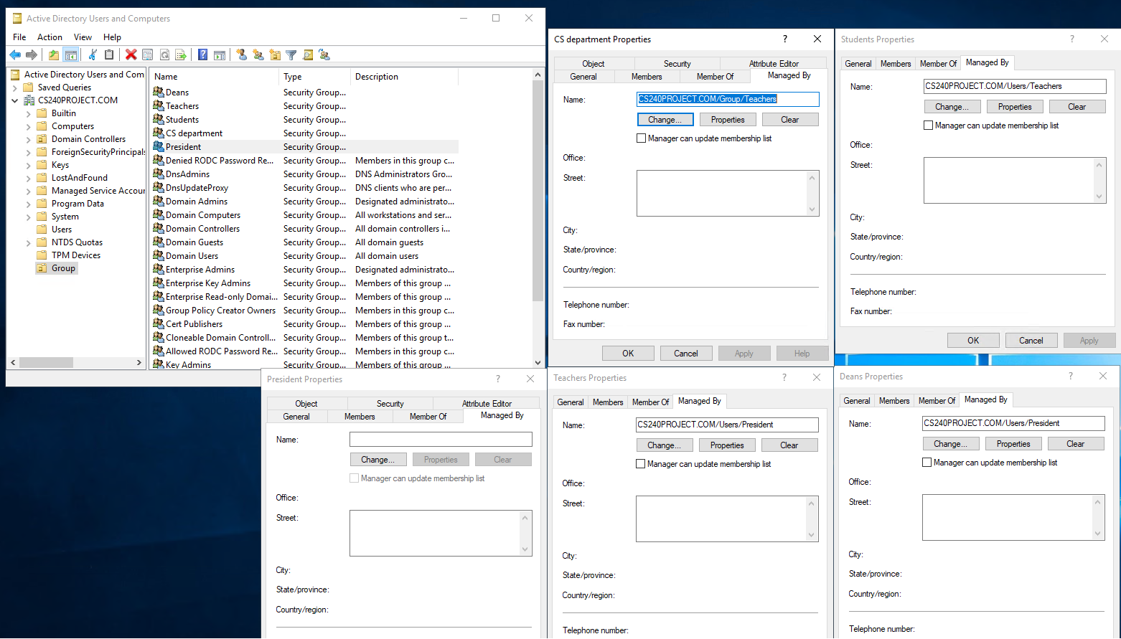
A bunch of Group Objects

Slide 9

Bonus Azure Fact!
Azure also contains a file share program, which allows one to create a virtual storage, and allow access to it from different endpoints. One of the options generates a powershell script: (Available upon request)
After pasting the script into powershell and running it, the drive will be attached to the device. This works both within the virtual machines created, as well as the local device. This could be great for transferring files across devices and geographies.
Notes:
$connectTestResult = Test-NetConnection -ComputerName cs240storage.file.core.windows.net -Port 445
if ($connectTestResult.TcpTestSucceeded) {
# Save the password so the drive will persist on reboot
cmd.exe /C "cmdkey /add:`"cs240storage.file.core.windows.net`" /user:`"Azure\cs240storage`" /pass:`"KiiDdNJSzju26w8d1QdB1x0QpaJcrthEwwXxn/1VT9VssZf6lL29lyDlFViLqDf6ts0ThYLQVxK59lS+TdR6Fw==`""
# Mount the drive
New-PSDrive -Name Z -PSProvider FileSystem -Root "\\cs240storage.file.core.windows.net\cs240share" -Persist
} else {
Write-Error -Message "Unable to reach the Azure storage account via port 445. Check to make sure your organization or ISP is not blocking port 445, or use Azure P2S VPN, Azure S2S VPN, or Express Route to tunnel SMB traffic over a different port."
}

Slide 10
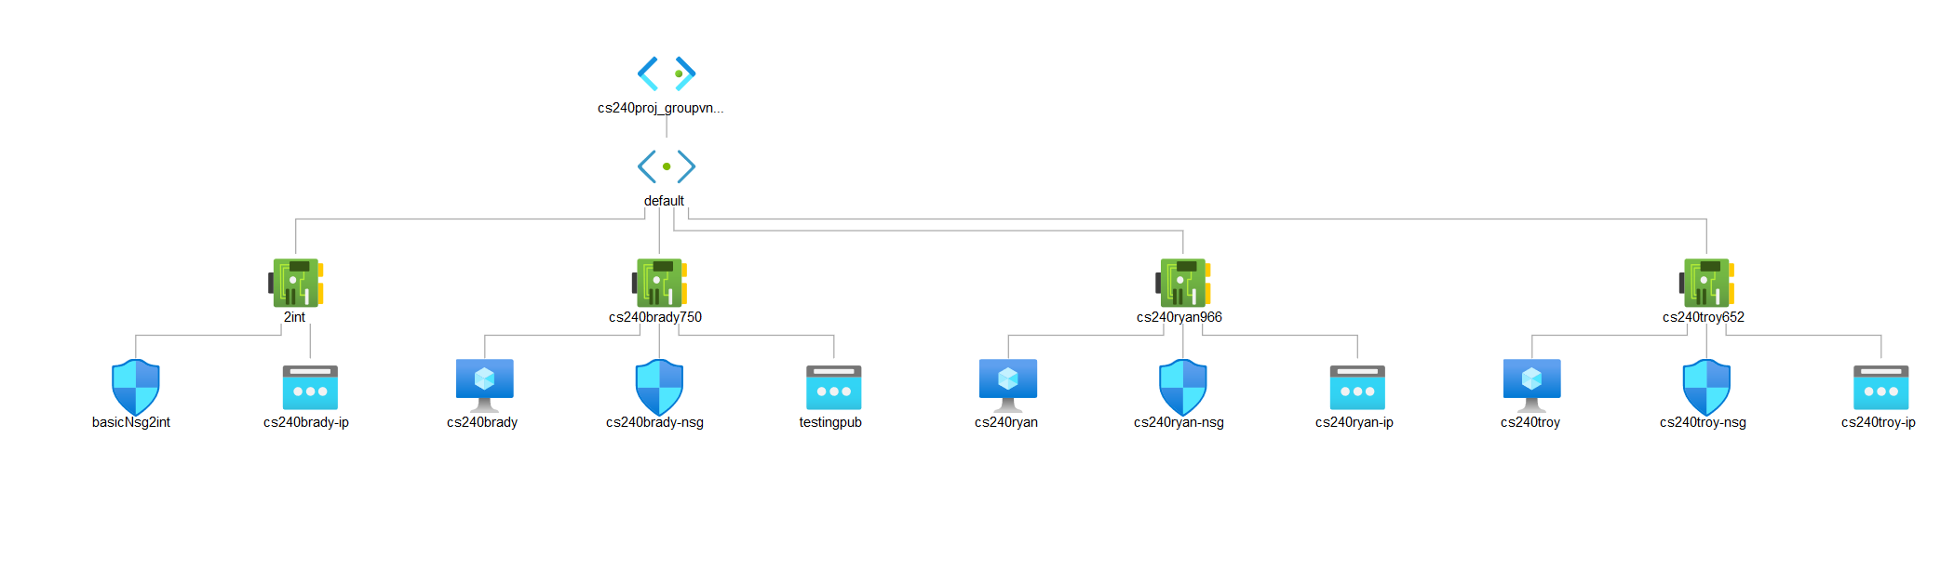
Our Network Diagram, courtesy of Azure
Notes:
Discovered “network watcher” feature in azure, one of the options inside allows one to view the virtual topology we have created.

